Slide 1




TACTICAL COMBAT CASUALTY CARE COURSE
Module 5: Tactical Trauma Assessment
#TCCC-CPP-PPT-05 08 AUG 23
COMBAT PARAMEDIC/ PROVIDER
MODULE 5:
TACTICAL TRAUMA ASSESSMENT
TCCC TIER 1
All Service Members
TCCC TIER 2
Combat Lifesaver
TCCC TIER 3
Combat Medic/Corpsman
TCCC TIER 4
Combat Paramedic/Provider
Notes:
Presenter
2023-11-22 10:58:22
--------------------------------------------
In this module, we will introduce you to the concept of a tactical trauma assessment, or TTA. It involves assessing injuries, prioritizing treatments, and coordinating the care of a combat casualty. The practical application of this information in the form of skill stations and trauma lanes will take place throughout the rest of the course. It will also be evaluated at the end of the course in your final assessment.

Slide 2




Module 5: Tactical Trauma Assessment
TACTICAL COMBAT CASUALTY CARE (TCCC) ROLE-BASED TRAINING SPECTRUM
ROLE 1 CARE
NONMEDICAL PERSONNEL
MEDICAL PERSONNEL
YOU ARE HERE
STANDARDIZED JOINT CURRICULUM
#TCCC-CPP-PPT-05 08 AUG 23
2
Notes:
Presenter
2023-11-22 10:58:22
--------------------------------------------
As a Combat Paramedic/Provider (CPP), you may be the first medical provider to care for the casualty and initiate more advanced treatments. In addition to knowing your role, it is important that you understand the potential roles and responsibilities of the nonmedical personnel, like Combat Lifesavers (CLS), as well as other Combat Medics/Corpsmen (CMC), who may also be assessing casualties and providing care, or assisting in the prehospital environment.

Slide 3
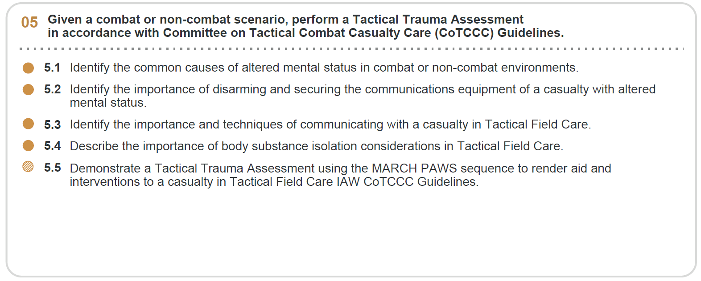







Module 5: Tactical Trauma Assessment
1 x TERMINAL LEARNING OBJECTIVES
Given a combat or non-combat scenario, perform a Tactical Trauma Assessment
in accordance with Committee on Tactical Combat Casualty Care (CoTCCC) Guidelines.
05
  Identify the common causes of altered mental status in combat or non-combat environments.
  Identify the importance of disarming and securing the communications equipment of a casualty with altered mental status.
Identify the importance and techniques of communicating with a casualty in Tactical Field Care. Describe the importance of body substance isolation considerations in Tactical Field Care.
Demonstrate a Tactical Trauma Assessment using the MARCH PAWS sequence to render aid and interventions to a casualty in Tactical Field Care IAW CoTCCC Guidelines.
5.3
5.4
5.5
5 x ENABLING LEARNING OBJECTIVES
= Terminal Learning Objectives = Cognitive ELOs = Performance ELOs
#
#TCCC-CPP-PPT-05 08 AUG 23
3
Notes:
Presenter
2023-11-22 10:58:23
--------------------------------------------
The Tactical Trauma Assessment module has four cognitive and one performance learning objectives.
The cognitive learning objectives are to identify common causes of altered mental status, the importance of disarming and securing communications equipment from casualties with altered mental status, and the importance of communicating with the casualty.
The performance learning objectives are to demonstrate techniques for assessing a casualty’s mental status; communicating with a casualty during Tactical Field Care; using proper body substance isolation; using the MARCH PAWS sequence to assess a combat casualty; and demonstrating the appropriate actions and interventions for a casualty based on that assessment.

Slide 4

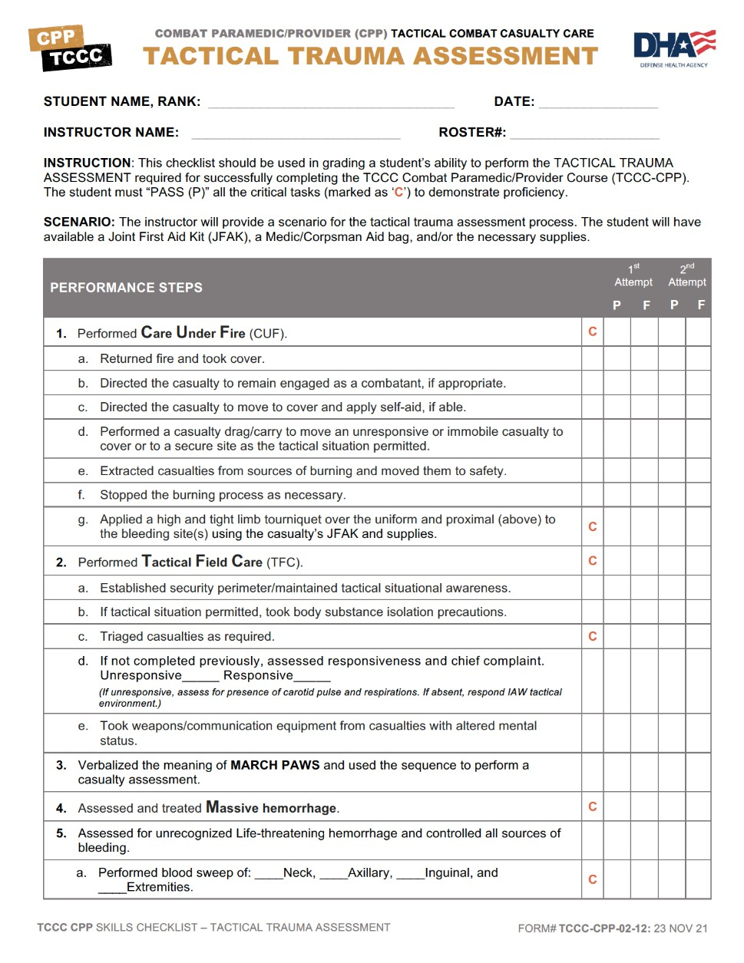
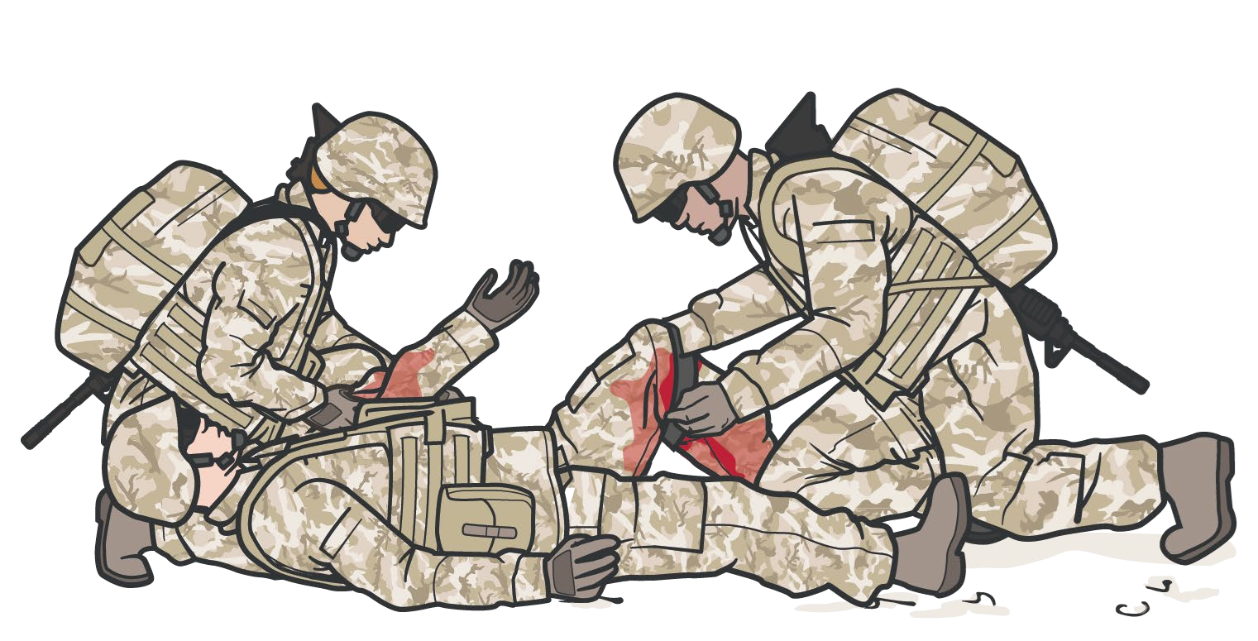
INTRODUCTION TO TACTICAL TRAUMA ASSESSMENT (TTA)
Standardized Approach to Assessing a Combat Casualty
Module 5: Tactical Trauma Assessment
RELIABLE & PROVEN METHODOLOGY
Allows seamless approach for multiple responders
Notes:
Presenter
2023-11-22 10:58:24
--------------------------------------------
The TTA is a standardized approach for assessing a combat casualty. It reflects a prioritized algorithm or sequence of steps that has been proven to maximize the effectiveness of TCCC interventions in saving lives on the battlefield. Also, with this standardized approach to assessment, responders can work together seamlessly, as each understands and can anticipate the next steps that should be taken in assessing and treating casualties throughout the continuum of care.

Slide 5


TACTICAL TRAUMA ASSESSMENT
Module 5: Tactical Trauma Assessment
INSTRUCTOR-LED Demonstration (Trainer-led demonstration review of the TTA sequence/key steps)
Notes:
Presenter
2023-11-22 10:58:24
--------------------------------------------
Since you will be expected to do a full tactical trauma assessment when you complete this training, your trainer(s) will lead a TTA demonstration. Provide an instructor-led demonstration
Do you have any comments or questions about the TTA?

Slide 6




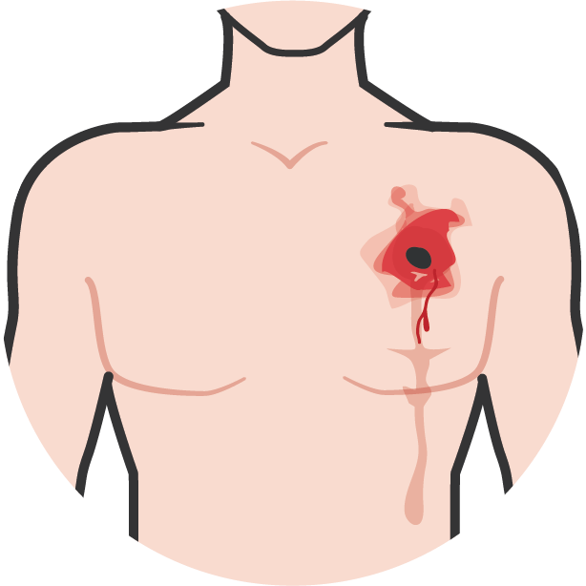
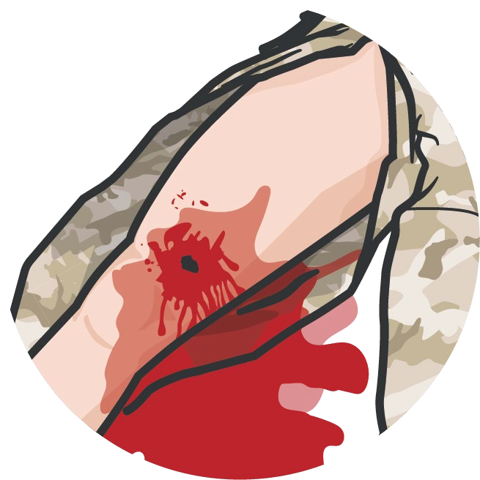

CAUSES OF ALTERED MENTAL STATUS
Module 5: Tactical Trauma Assessment
TRAUMATIC BRAIN INJURY
HYPOXEMIA
HYPOVOLEMIA/SHOCK
HYPOTHERMIA also contributes to altered mental status
Notes:
Presenter
2023-11-22 10:58:25
--------------------------------------------
Identifying casualties with altered mental status is important, as this can significantly affect the TTA.
Altered mental status has several potential causes, like metabolic, toxic, and infectious; but in the combat or trauma environment, the principal causes are traumatic brain injury, hypoxia, and hypovolemia from blood loss. Also, hypothermia, although not typically a primary cause, can exacerbate mental status changes. Some pain medications can alter a casualty’s mental status, and this should be considered when assessing the casualty. By determining the mechanism of injury and assessing a casualty’s verbal and nonverbal responses while attempting to communicate with them, you can determine if a casualty is not responding appropriately and exhibiting signs and symptoms of an altered mental status.

Slide 7
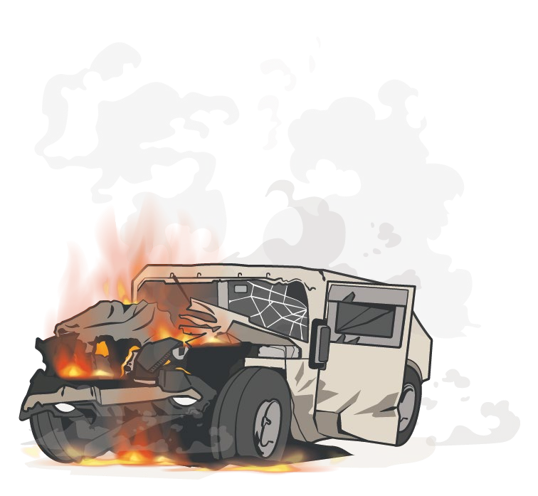
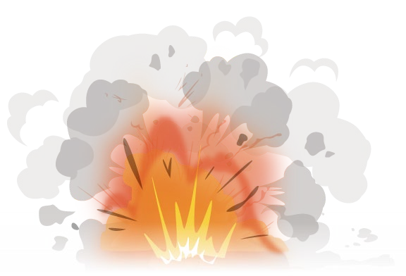
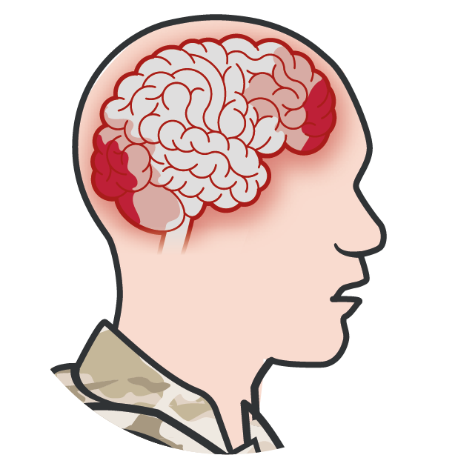
TECHNIQUES TO ASSESS RESPONSIVENESS ALTERED MENTAL STATUS
Module 5: Tactical Trauma Assessment
ASSESS THE MECHANISM OF INJURY
COMMUNICATE WITH THE CASUALTY
A
lert
V erbal Stimuli
P ainful Stimuli
U nresponsive
Blasts
MVAs
Direct Blow to the Head
Notes:
Presenter
2023-11-22 10:58:25
--------------------------------------------
The mechanism of injury is often your first clue that a casualty has received injuries that might lead to an altered mental status. Specifically, exposure to blasts and significant impacts can lead to head injuries that are not always accompanied by obvious external signs. Of course, the presence of injuries that cause massive hemorrhage or altered respiratory status increases the likelihood of hypovolemia and/or hypoxia, and should raise your suspicion that the casualty will have an altered mental status.
The initial rapid assessment of a casualty’s mental status comes from communicating with the casualty by asking them to follow commands and to answer questions. If the casualty is not responding appropriately (noticed by observing their verbal and nonverbal responses), this is a sign of an altered mental status. Later in the TTA, during the “H” of head injury evaluation, you will assess them using the AVPU technique. That involves assessing for responsiveness by validating whether the casualty is alert (the “A”), responds to your verbal commands appropriately (the “V”), responds to painful stimulation (the “P”), or is unresponsive (the “U”).

Slide 8

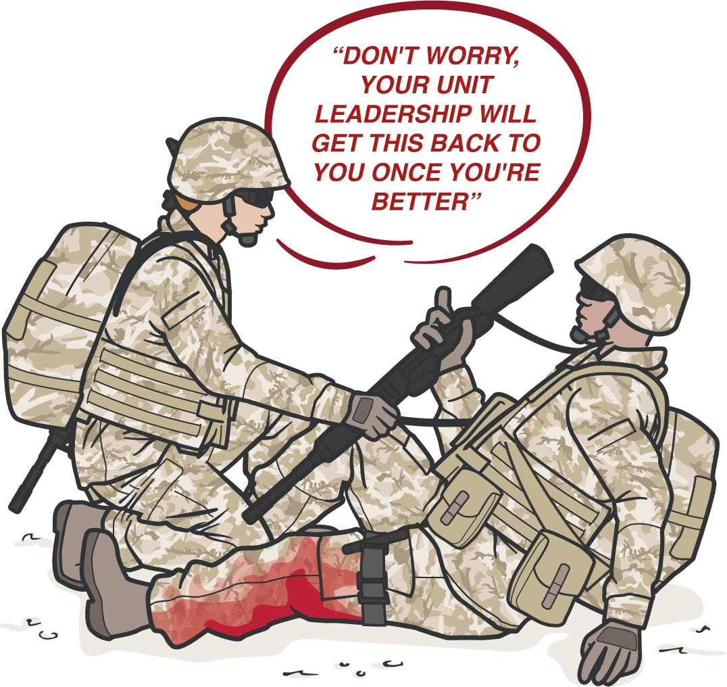


DISARMING CASUALTIES
AND SECURING COMM EQUIPMENT
Module 5: Tactical Trauma Assessment
“DON'T WORRY, YOUR UNIT WILL GET THIS BACK TO YOU ONCE YOU'RE BETTER”
REMOVE CASUALTY’S
WEAPON, unit leadership will take responsibility for it
If casualty has communication equipment, have the unit leadership take control of it, as well
Notes:
Presenter
2023-11-22 10:58:25
--------------------------------------------
Casualties with an altered mental status often act (and react) inappropriately, and can even be a potential danger to themselves, first responders, and their unit, without being aware that their actions are improper.
Because of the possible threat this presents, responders must recognize when a casualty has an altered mental status and take steps to disarm the casualty and secure any communication equipment they may be carrying. Casualties are likely to resist this but will usually respond to reassurance that you are securing their equipment while you care for them and that their unit will take responsibility for it.

Slide 9

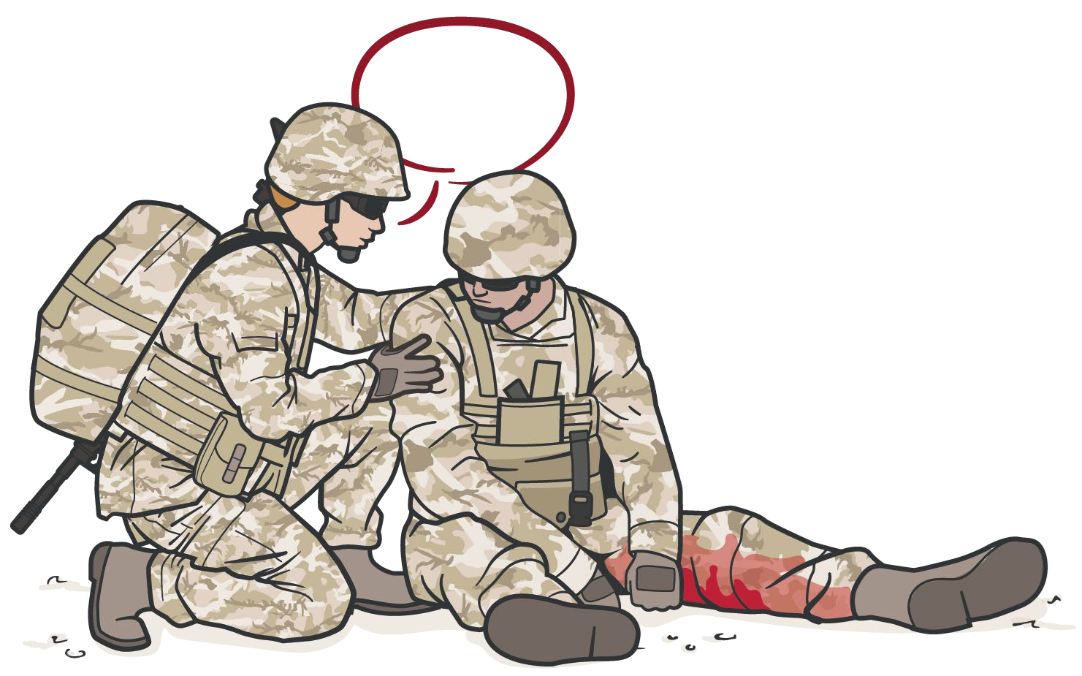
COMMUNICATE WITH CASUALTIES
Module 5: Tactical Trauma Assessment
Frequent Communication may help the casualty feel calmer and improve their outcome by - reducing stress, increasing the ability to explain symptoms and follow commands.
COMMUNICATE with the casualty, if possible
Encourage AND Reassure
Explain care each step of the way
Communicate throughout TTA to determine if the casualty's mental status begins to change – a potential sign that something is wrong, and they need to be reassessed
Notes:
Presenter
2023-11-22 10:58:26
--------------------------------------------
In the prior module, communication with the casualty was also highlighted, along with some techniques to consider.
Communicating with the casualty is vitally important for several reasons. One is to help calm and reassure the casualty in what is likely the most stressful situation that they have ever experienced. If they are calmer, they will follow your instructions more closely, which may result in a better outcome. Also, as previously mentioned, communicating with the casualty allows you to assess their mental status and identify any changes over time that might lead you to an early reassessment of the casualty’s status.

Slide 10

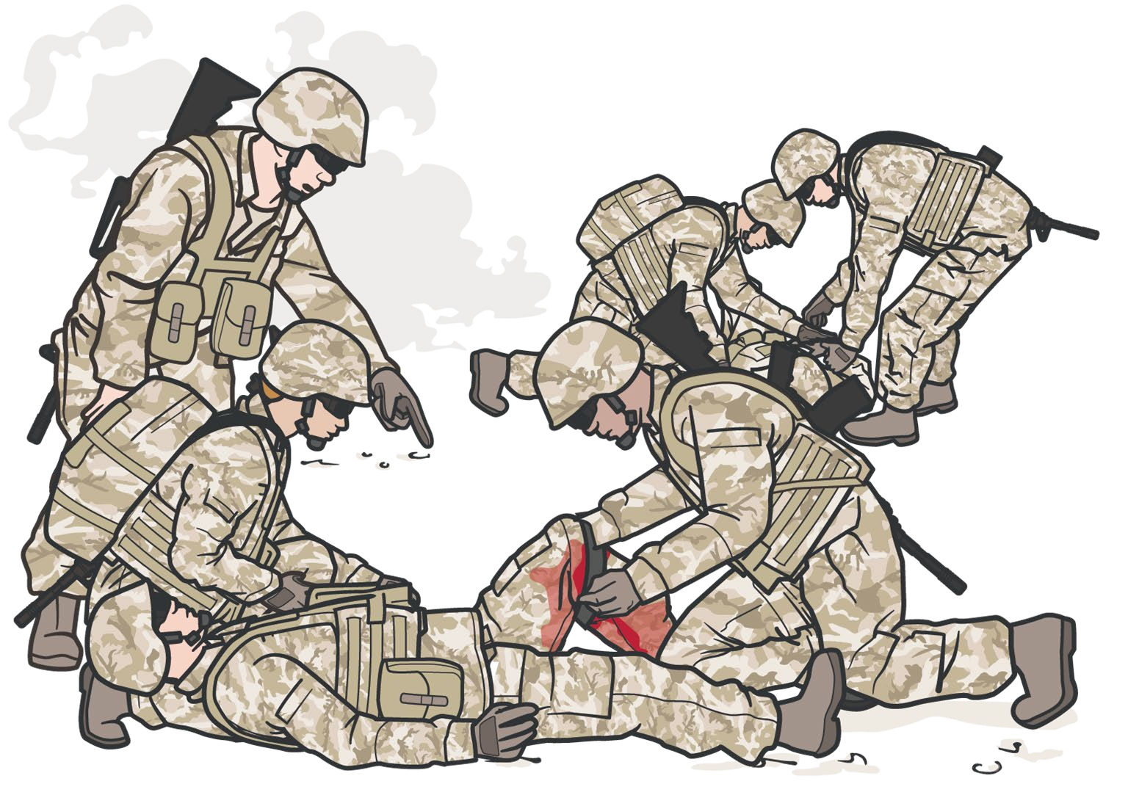
TRIAGE AND DIRECT OTHER RESPONDERS
Module 5: Tactical Trauma Assessment
If MULTIPLE CASUALTIES
are present, you may need to TRIAGE before starting an individual casualty TTA
DIRECT COMBAT MEDIC CORPSMEN, COMBAT
LIFESAVERS or other responders to help – you cannot do everything yourself
Notes:
Presenter
2023-11-22 10:58:26
--------------------------------------------
As mentioned in the prior modules on the Principles of Tactical Field Care, you may have more than one casualty. You may need to triage casualties, direct the actions of other responders, and allocate your limited resources before beginning on an individual casualty assessment.

Slide 11

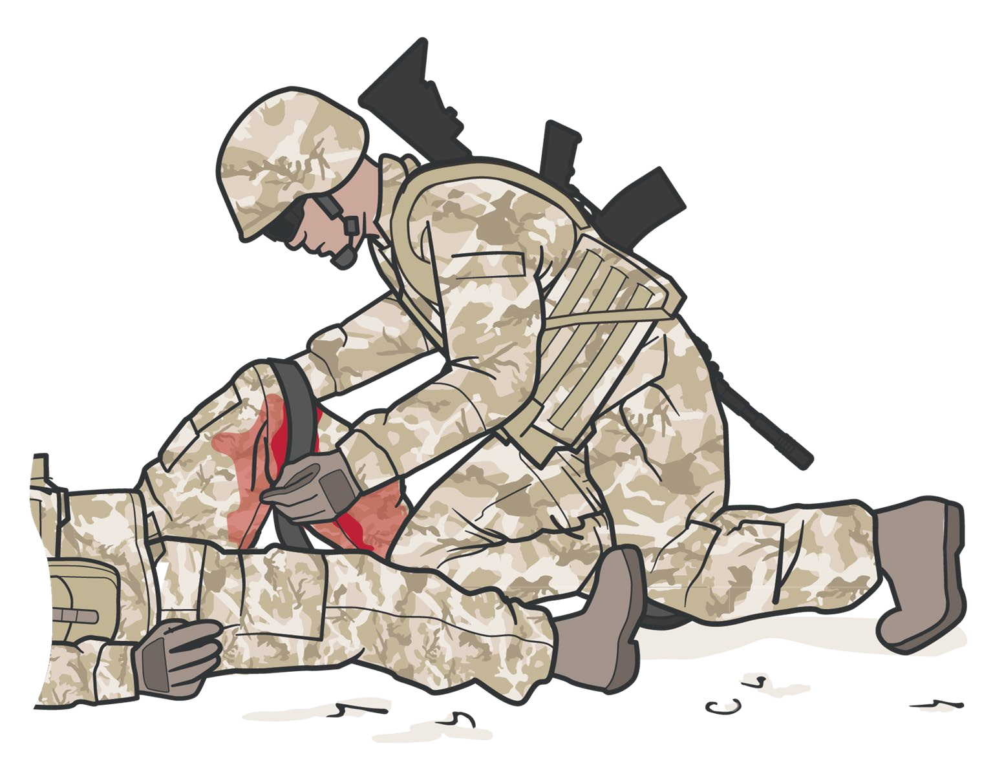




BODY SUBSTANCE ISOLATION (BSI)
Module 5: Tactical Trauma Assessment
As a precaution, the responder should don latex-free gloves whenever possible
In CARE UNDER FIRE or other tactical situations, BSI may not be feasible
Notes:
Presenter
2023-11-22 10:58:27
--------------------------------------------
Body substance isolation (or BSI) is a situation-dependent consideration in TCCC. For example, in Care Under Fire, there is no time to worry about body substance isolation, although your tactical gloves do offer some level of protection. However, once in Tactical Field Care, whenever possible, responders should don latex-free gloves as a BSI precaution. Gloves are found in most equipment kits, including the Joint First Aid Kit, CLS bags, Combat Medic/Corpsmen aid bags and CPP equipment bags.

Slide 12
TTA SEQUENCE
Module 5: Tactical Trauma Assessment
DURING LIFE-THREATENING AFTER MARCH
AFTER PAWS
M A R CH
MASSIVE BLEEDING REASSESS MARCH
REASSESS MARCH PAWS
CUF or TFC
AIRWAY
#1 Priority
P A W S
PAIN
PREPARATION FOR EVACUATION
RESPIRATION (breathing)
ANTIBIOTICS
CIRCULATION
WOUNDS
CONSIDER DETAILED EXAMINATION
HYPOTHERMIA / HEAD INJURIES
SPLINTING
COMMUNICATION AND DOCUMENTATION
Notes:
Presenter
2023-11-22 10:58:27
--------------------------------------------
As you might expect, the TTA should begin by adhering to the MARCH PAWS sequence; understanding that massive hemorrhage assessment and treatment may begin in Care Under Fire while establishing fire superiority, extracting the casualty from burning vehicles or buildings, and moving them to safety, if appropriate. But most of the TTA occurs in Tactical Field Care, where further assessment and treatment following the full MARCH PAWS sequence can continue. Communication and documentation are key principles throughout the assessment. As Combat Paramedics or Providers with additional skills and equipment, you may have time to perform a more detailed exam as part of a secondary assessment. The tactical trauma assessment can guide casualty care from point of injury through evacuation to higher-level care.

Slide 13
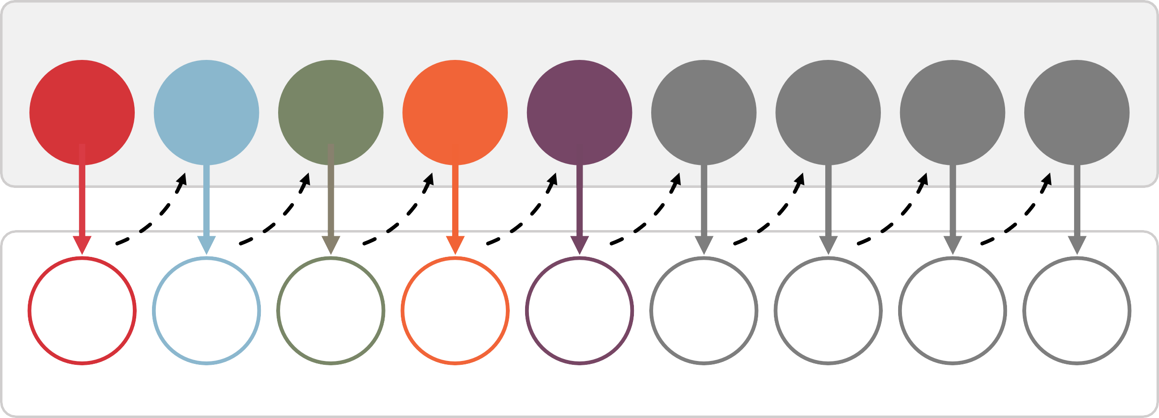
TACTICAL TRAUMA ASSESSMENT PROCESS
Module 5: Tactical Trauma Assessment
Assessment
M A R C H P A W S
M A R C H P A W S
Intervention(s)
Notes:
Presenter
2023-11-22 10:58:28
--------------------------------------------
Throughout the rest of the course, we will cover the interventions and procedures of MARCH PAWS in more detail. Although we’ll take a moment to highlight some key concepts that apply throughout the TTA, we’ll defer discussions about the specific interventions until their corresponding module. For now, the focus should be more on the process than on the details of each procedure.
Remember that when performing an assessment, you will need to go back and forth from assessing the need for an intervention to performing a skill, and then return to assessing for the next potential injury. So, although we call this an assessment, the entire process is a combination of an assessment and a treatment plan being executed simultaneously.

Slide 14


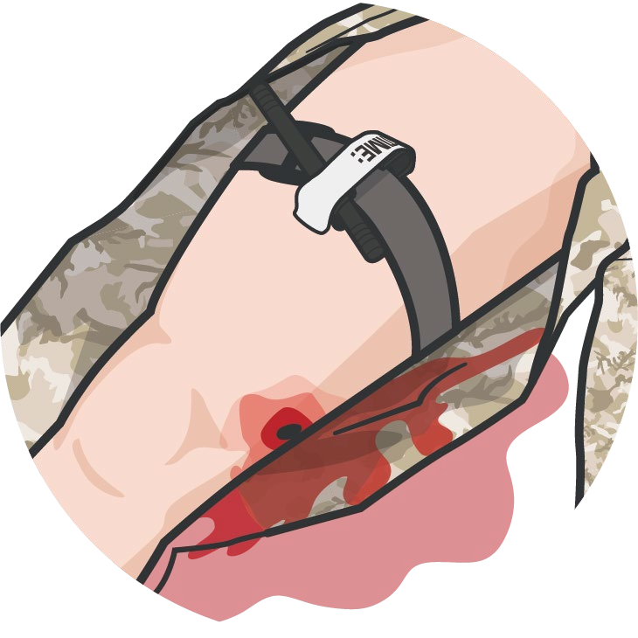
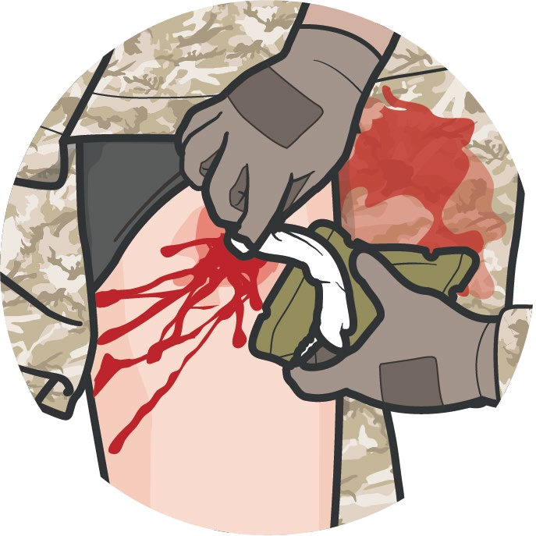


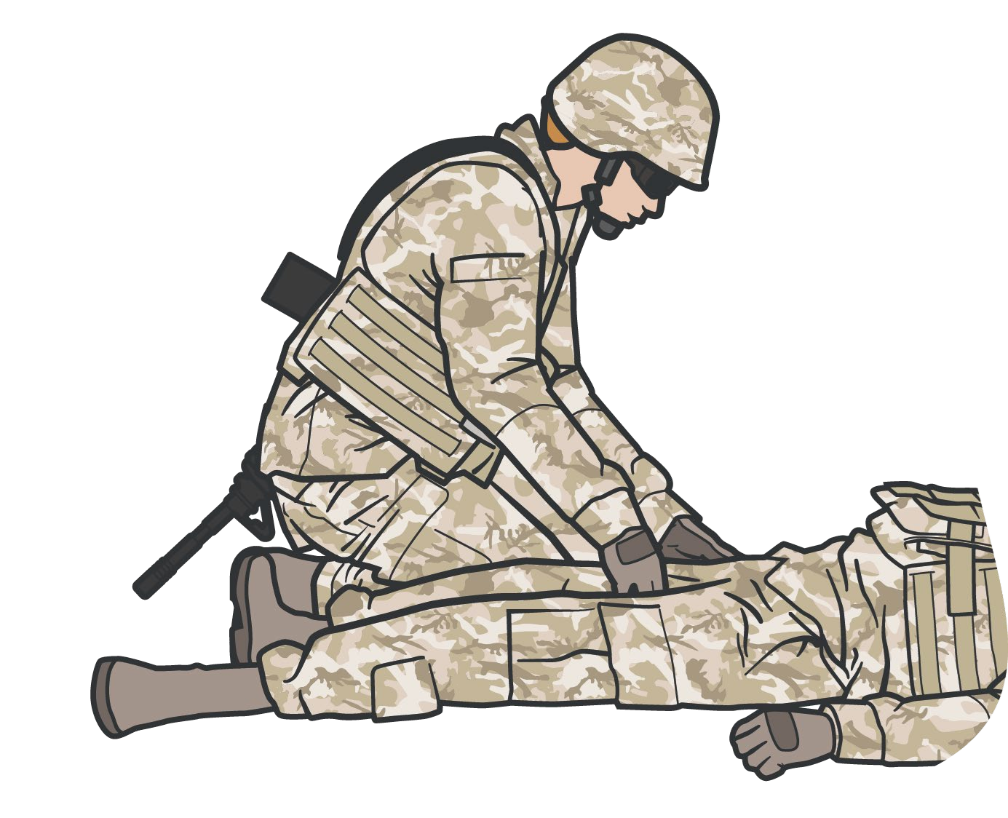
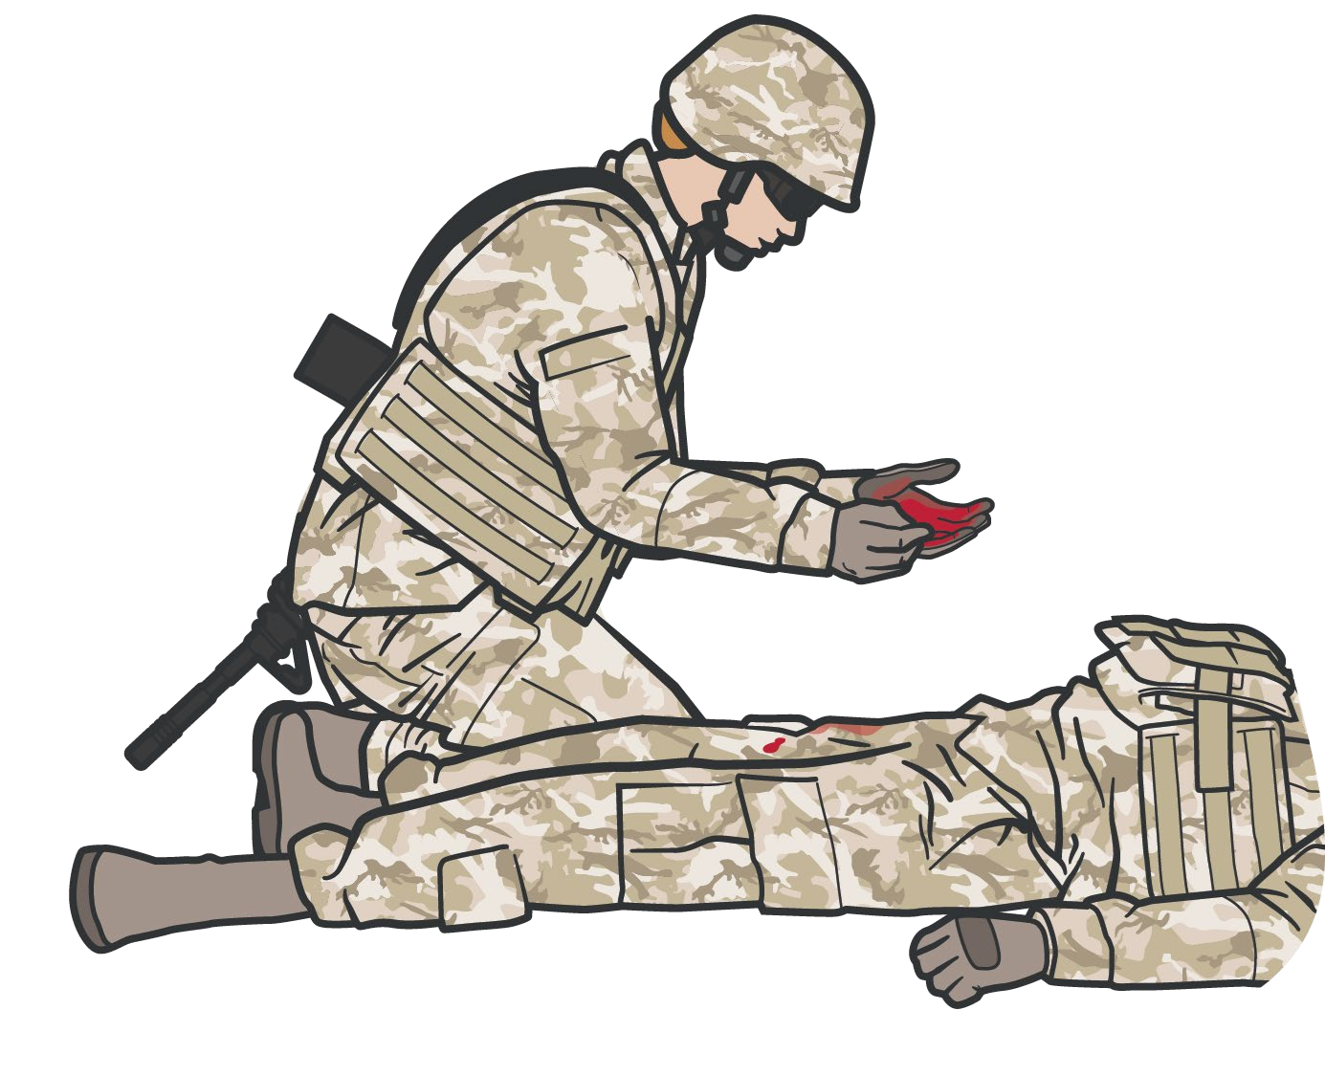

BEGIN WITH HEMORRHAGE CONTROL AND BLOOD SWEEP
Module 5: Tactical Trauma Assessment
After treating obvious massive hemorrhage, do a rapid head-to-toe check for any unrecognized life- threatening bleeding
M
Treat any obvious massive hemorrhage with limb tourniquets, wound packing, pressure bandages, or junctional tourniquets, as appropriate
Check the neck, axillary, and inguinal areas Check the arms and legs
CONSIDER the application of a pelvic binder in relation to the MOI
Notes:
Presenter
2023-11-22 10:58:29
--------------------------------------------
During the Care Under Fire phase conduct a visual blood sweep and apply CoTCCC-recommended limb tourniquet for hemorrhage that is anatomically amenable to tourniquet use.
In Tactical Field Care, immediately apply a tourniquet, hemostatic dressing, pressure dressing, or junctional tourniquet, as appropriate, to control massive hemorrhage. Part of the assessment at this point is to perform a head-to-toe check for any unrecognized life-threatening bleeding (called a blood sweep). This blood sweep is a visual and manual (palpating with your hands) inspection of the front and back of the casualty from head to toe, including the neck, axillae, and groin.

Slide 15





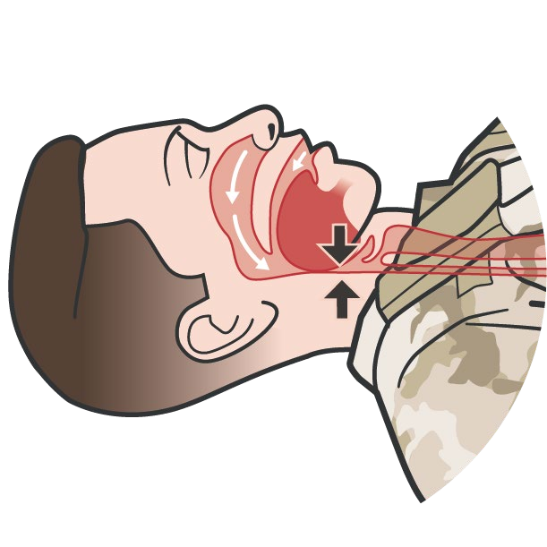
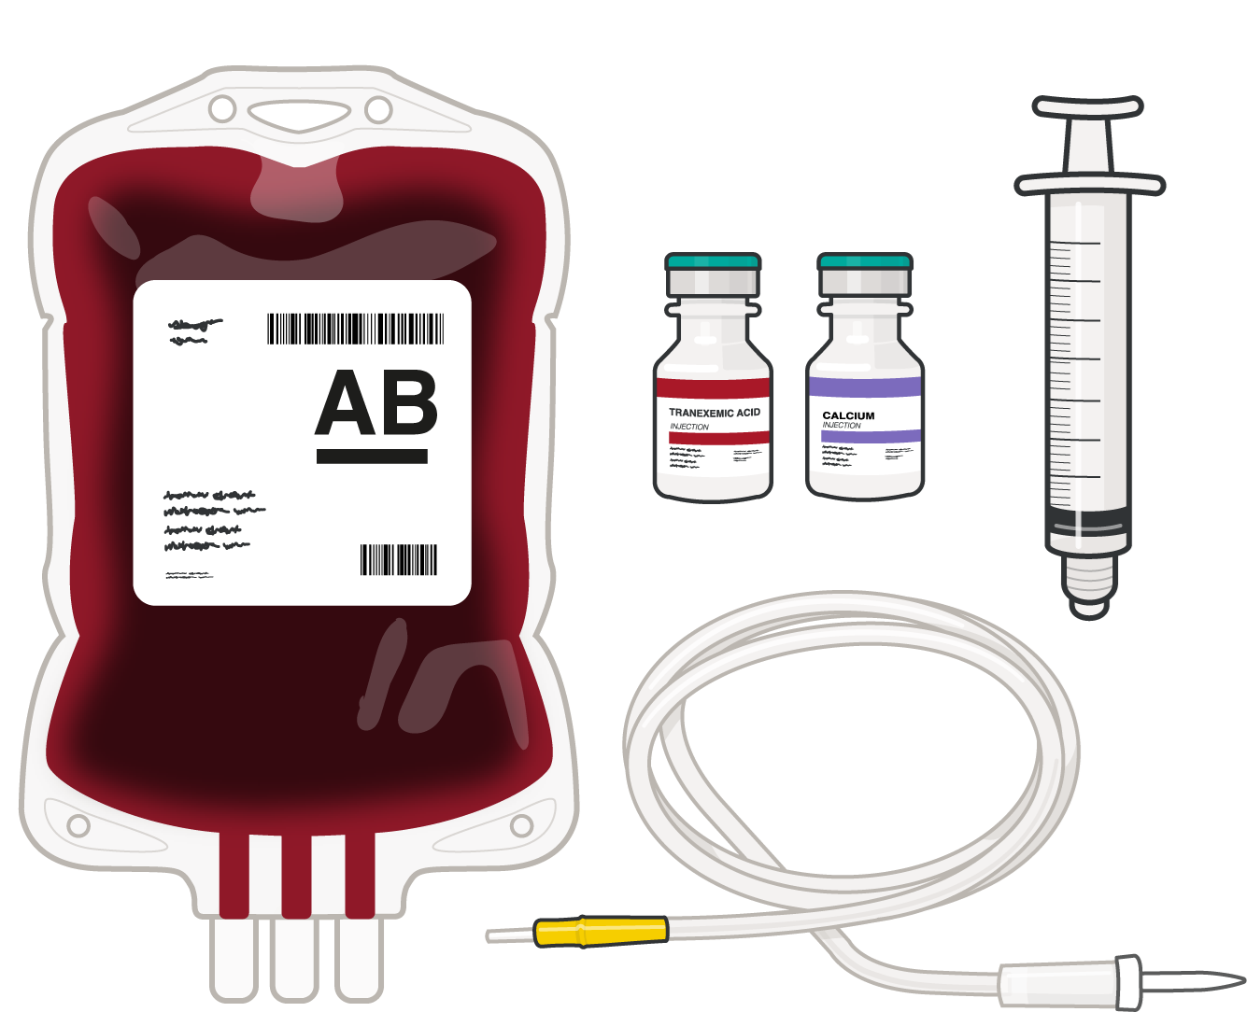
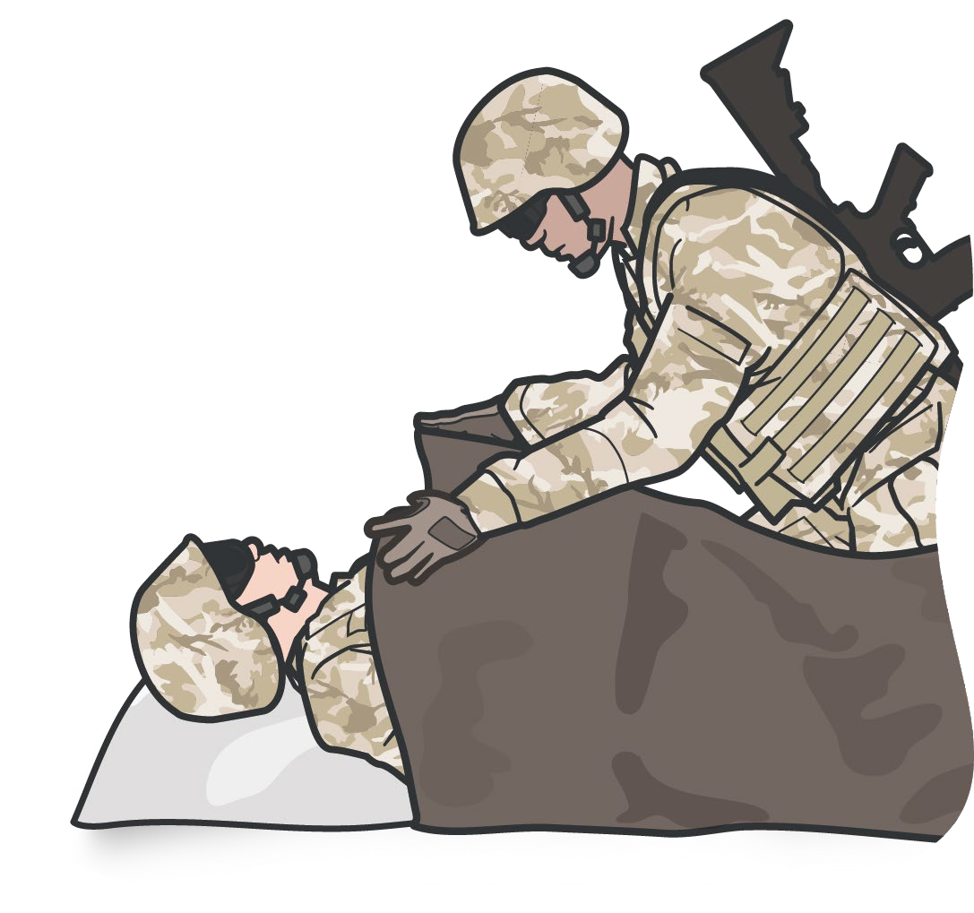
CONTINUE TTA WITH REST OF MARCH SEQUENCE
Module 5: Tactical Trauma Assessment
A
Relieve any airway obstructions or pending airway obstructions with maneuvers, adjuncts, or establish a new airway surgically or via intubation
R
Treat open chest wounds with vented chest seals and tension pneumothorax with needle decompression of the chest
C
Establish intravenous or intraosseous access and treat hemorrhagic shock with blood products
H
Use active and passive measures to prevent or treat hypothermia
Assess and document head and penetrating eye injuries
Notes:
Presenter
2023-11-22 10:58:30
--------------------------------------------
Once life-threatening hemorrhage has been addressed, the remaining MARCH sequence assessments and treatments can proceed.
If you identify an airway obstruction, you should open it using either airway maneuvers or airway adjuncts. If those are not successful, you may need to establish an airway. Sometimes an additional responder, such as a Combat Lifesaver, may be needed to help maintain an airway once reestablished. Respiratory insufficiency may be from several different causes, and common trauma sources often respond to chest seals, or needle decompressions if a tension pneumothorax is present.
Circulation often focuses on applying a pelvic binder for cases of suspected pelvic fractures; reassessing prior tourniquet application; treating shock, when present, by establishing intravenous or intraosseous access; and replacing blood losses with blood products. Treat hypothermia with active and passive measures. Consider it a risk despite the ambient temperature of the environment. Assess and document any head injuries and penetrating eye injuries.

Slide 16
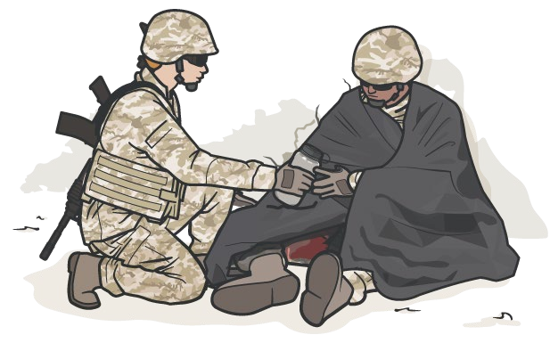
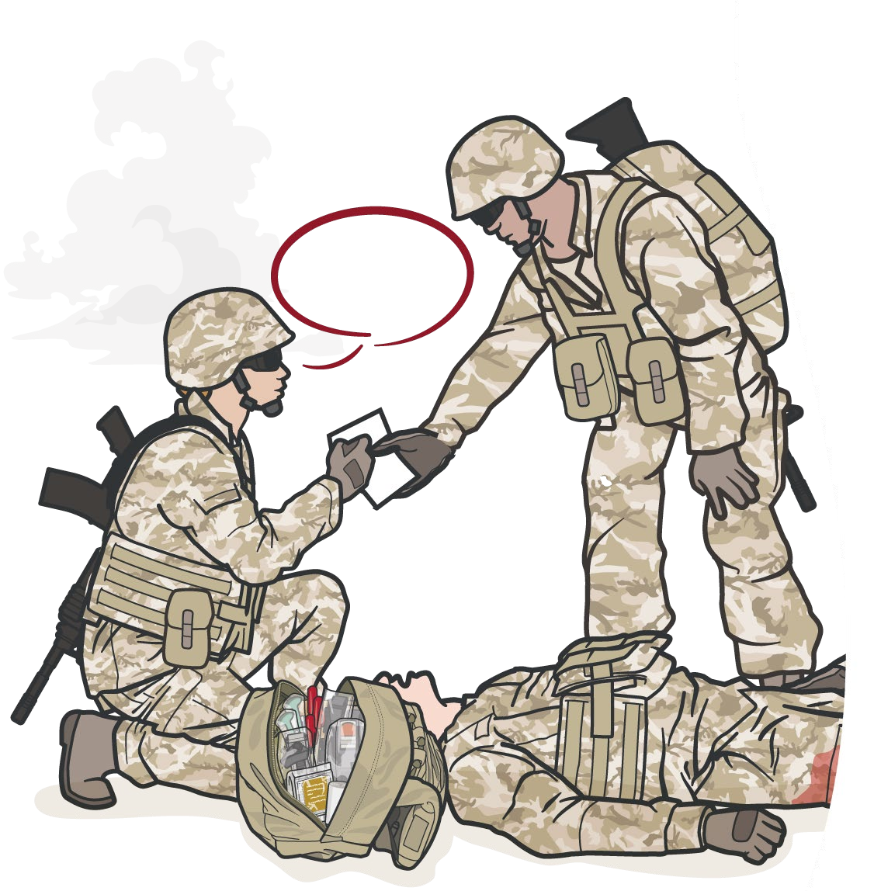
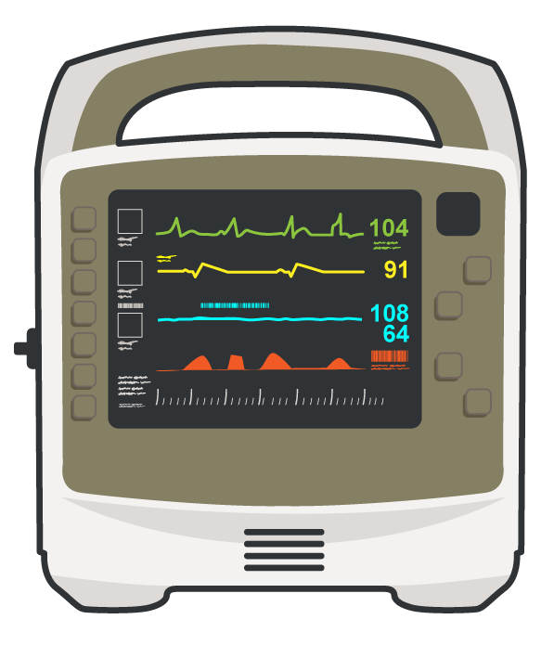
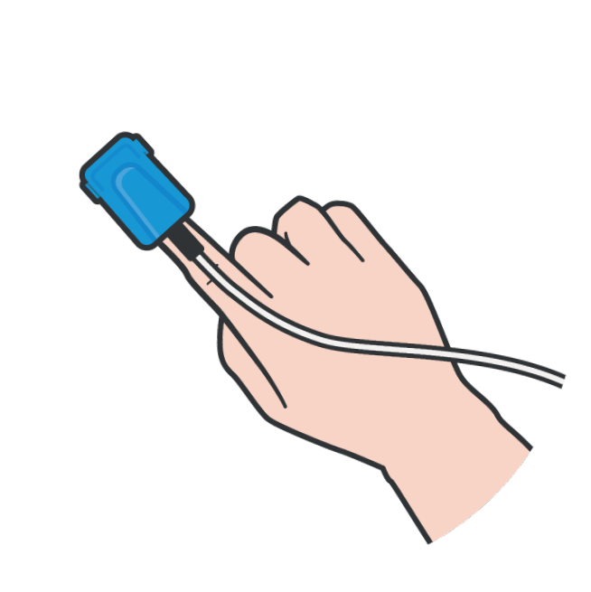
Module 5: Tactical Trauma Assessment
INITIATE MEDICAL EVACUATION
PREPARE EVAC REQUEST
Relay required MEDEVAC Request information to the tactical leader in accordance with unit standard operating procedures
MONITOR THE CASUALTY
REASSESS all lifesaving interventions (MARCH sequence) and continue with the PAWS portion if time permits
Initiate ELECTRONIC MONITORING, if indicated and equipment is available
REASSESS MARCH interventions prior to proceeding to PAWS
Notes:
Presenter
2023-11-22 10:58:30
--------------------------------------------
These three efforts will help in the success in ensuring the best possible outcome for your casualty:
1. Relay required MEDEVAC request information to the tactical leader in accordance with unit standard operating procedures 2. REASSESS all lifesaving interventions (MARCH sequence) and continue with the PAWS portion if time permits
3. INITIATE ELECTRONIC MONITORING if indicated and equipment is available
Before moving to the PAWS in the MARCH PAWS sequence, it is important to initiate a medical evacuation request, if tactically feasible. Delaying this step until the very end of the TTA potentially delays the evacuation and increases the risk of an adverse casualty outcome. Relay the required MEDEVAC request information to the tactical leader in accordance with unit standard operating procedures This is also the time in the TCCC Guidelines where monitoring is highlighted, and you should initiate advanced electronic monitoring if indicated and if monitoring equipment is available.
And before proceeding to the next step, reassess MARCH interventions to ensure nothing has changed or been overlooked.

Slide 17

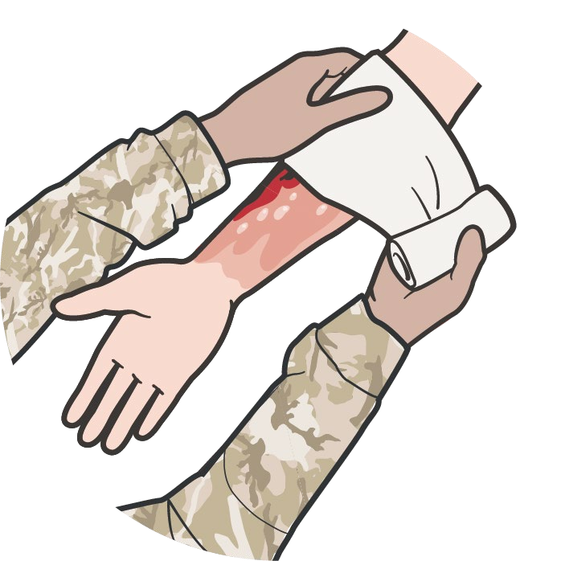
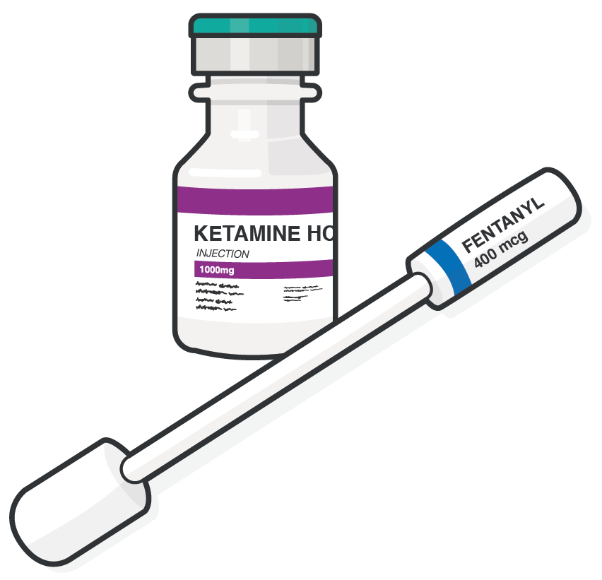
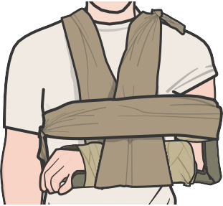
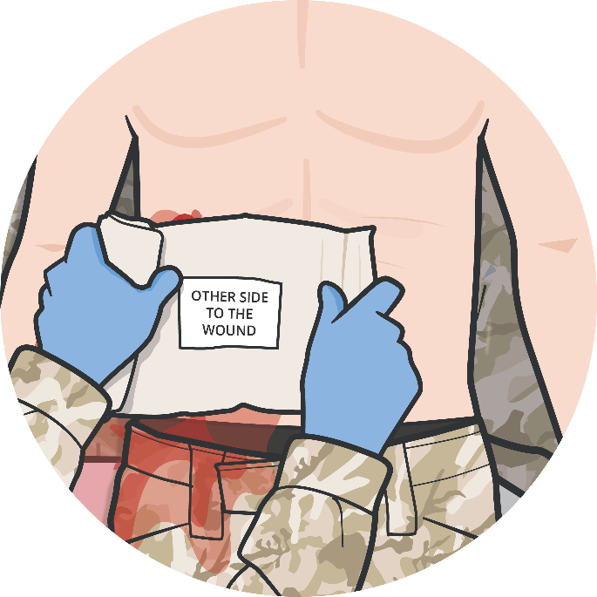
COMPLETE THE TTA BY ADDRESSING PAWS
Module 5: Tactical Trauma Assessment
P
Assess for pain and administer the appropriate pain control medications
A
Administer antibiotics for all open combat wounds
W
Address additional wounds (abdominal injuries, impaled objects, burns, minor lacerations, etc.) as soon as possible
S
Splint and secure
fractures before evacuation (if time permits)
#TCCC-CPP-PPT-05 08 AUG 23
17
Notes:
Presenter
2023-11-22 10:58:31
--------------------------------------------
Once you have assessed the MARCH sequence and identified, treated any life-threatening issues, and initiated the evacuation request, the next steps follow the PAWS sequence. Assess for pain and administer the appropriate pain control medications, keeping in mind the potential effect they may have on the casualty’s mental status.
When appropriate, initiate antibiotic treatment.
Several non-life-threatening wounds can result in significant long-term disability or deteriorate into life-threatening complications and need to be addressed as soon as possible. These include abdominal injuries, impaled objects, burns, or other soft tissue injuries. And fractures are common in the trauma environment and should be splinted and secured for evacuation.

Slide 18
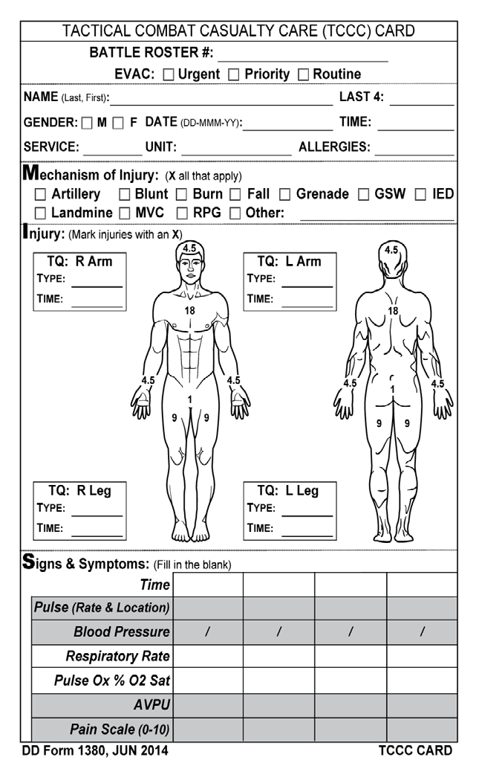
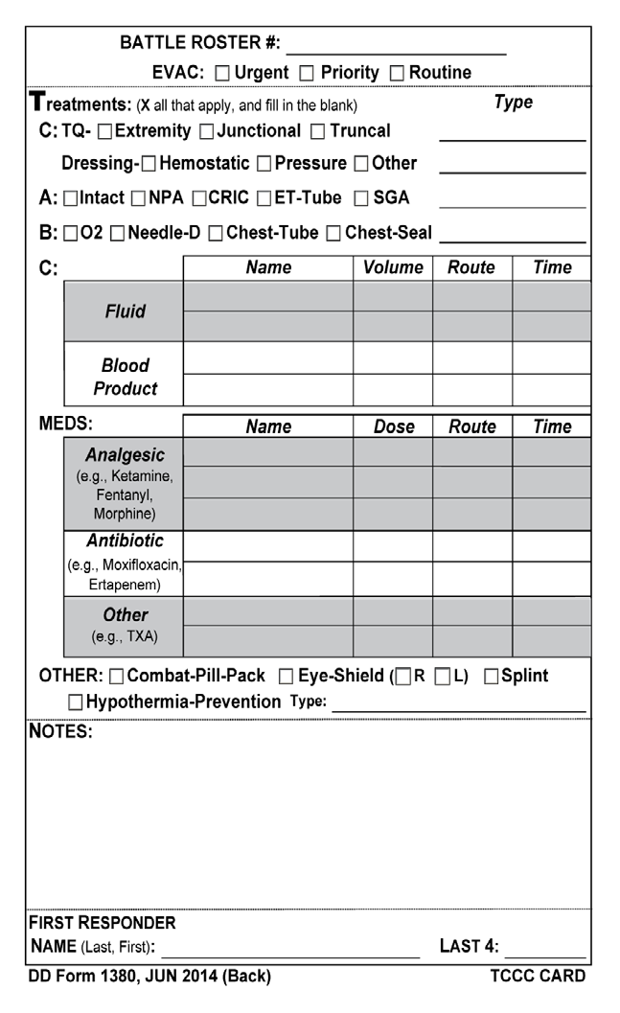
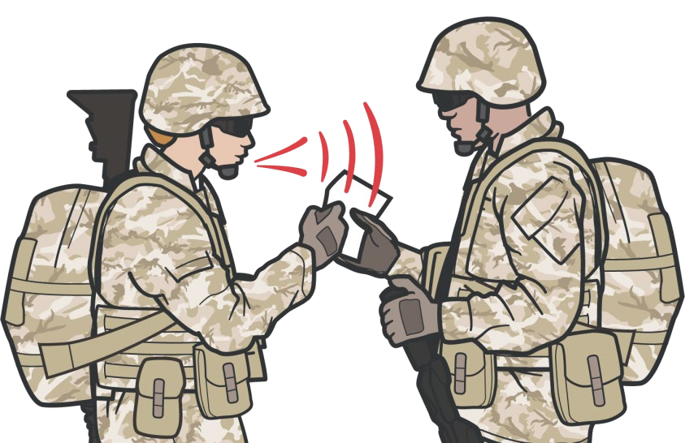
COMMUNICATION AND DOCUMENTATION
Module 5: Tactical Trauma Assessment
FRONT
BACK
COMMUNICATE
with tactical leadership as soon as possible with status and evacuation requirements throughout casualty treatment as needed
DOCUMENT
on the DD Form 1380 ALL assessments and treatments provided to casualties before evacuation or handoff to other medical personnel
Notes:
Presenter
2023-11-22 10:58:32
--------------------------------------------
The next steps in the TCCC Guidelines, and the TTA, are communication and documentation.
As soon as you have determined the extent of the casualty’s injuries and treated any life-threatening issues, communicate with leadership about the casualty status and the need for medical evacuation. You may even provide basic evacuation requirements before addressing non-life-threatening injuries. Communicating with leadership is an ongoing process that should occur early and often, as you will be rightfully focused on casualty care and need to rely on other unit personnel to initiate the evacuation and pool resources to help you manage casualty movement. Begin documentation on the casualty’s DD Form 1380 as soon as is feasible, without compromising casualty care. Regularly update documentation throughout the rest of the assessment.

Slide 19
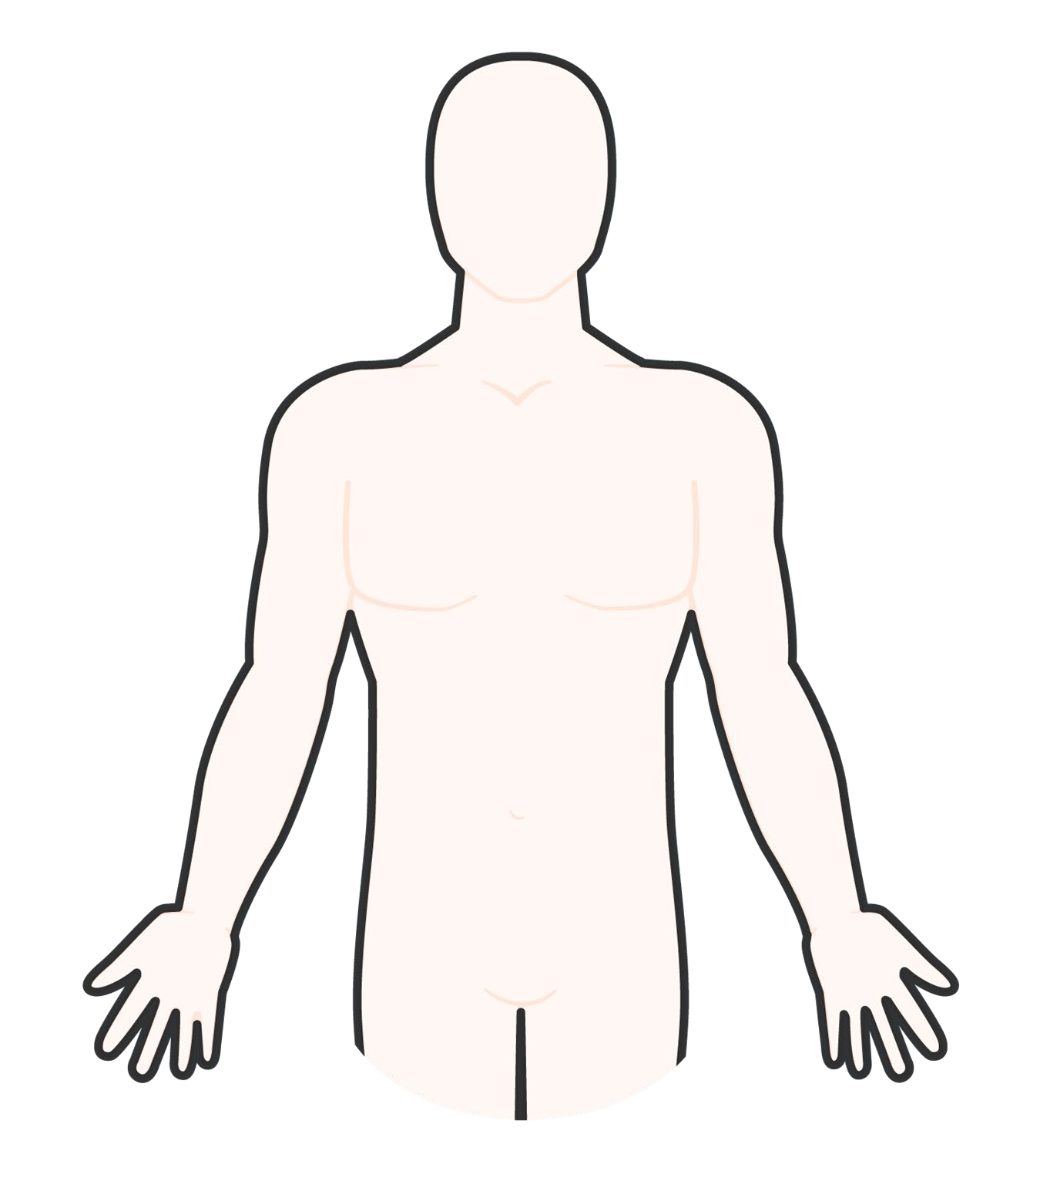



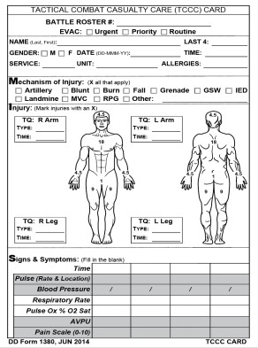
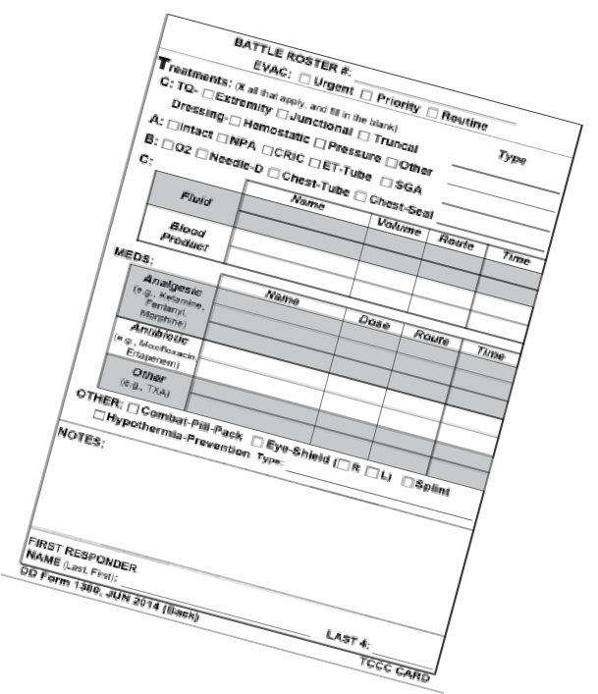
SECONDARY ASSESSMENT/DETAILED EXAM
Module 5: Tactical Trauma Assessment
Start at the head and work your way to the toes
Reassess and Treat
1
2
Head Neck
7 Thorax, Lumbar, and Buttocks
Upper Extremities
all prior interventions
Treat minor injuries as they are found
Document any findings on the DD Form 1380
3
Chest
6
4 Abdomen/ Pelvis, Groin, Perineum
5
Lower Extremities
The detailed examination takes some time, and may not be an option if evacuation is ready or multiple casualties require attention
Notes:
Presenter
2023-11-22 10:58:33
--------------------------------------------
If time and tactical situation permit, perform a detailed examination and secondary assessment. This is most commonly done from head to toe, to ensure that the examination is complete, and nothing is overlooked. This includes the head, neck, chest, abdomen, pelvis, perineum, lower extremities, upper extremities, posterior thorax, lumbar area, and buttocks. Reassess all prior interventions and communicate with the casualty to evaluate the casualty’s status. If you find any minor injuries, treat them as appropriate and document.

Slide 20
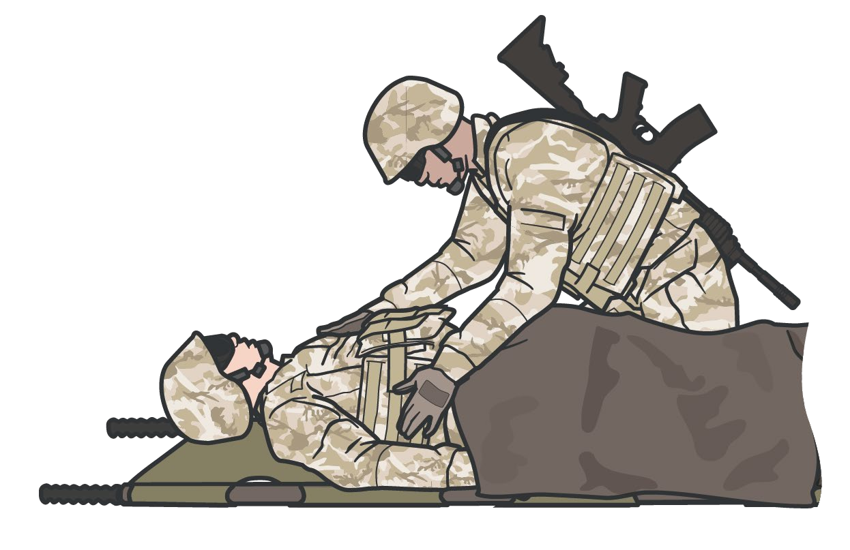
REASSESS TREATMENTS
Module 5: Tactical Trauma Assessment
REASSESS ALL treatments following
M A R C H
Focus on MARCH if time is limited
P A W S
Reassess in the same sequence as the original TTA
Reassess frequently, in particular, after any casualty movement, changes in casualty's symptoms or signs, and before transitioning care to another provider
Notes:
Presenter
2023-11-22 10:58:33
--------------------------------------------
Reassessment is a critical step and a continuous process. It should be deliberate and follow the same sequence and priority as the initial assessment. Reassess all interventions for effectiveness. Reassessment is particularly important after casualty movement or if deterioration in casualty status is noted.

Slide 21
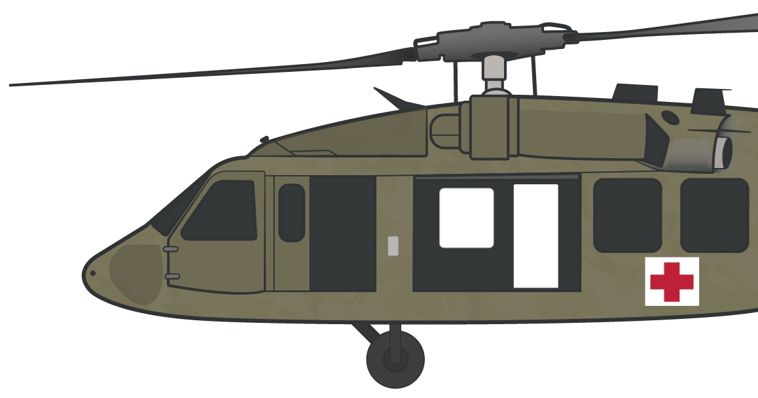
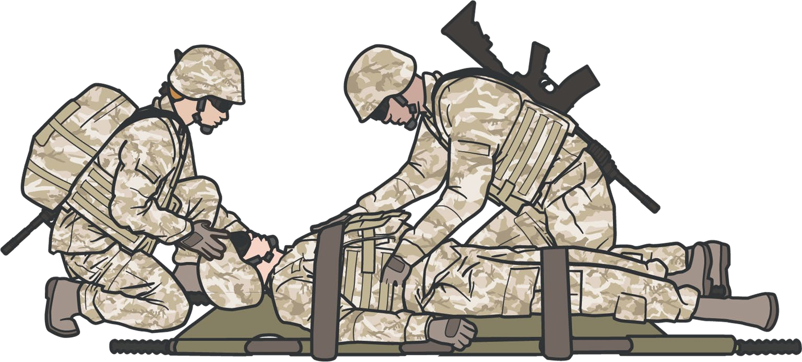


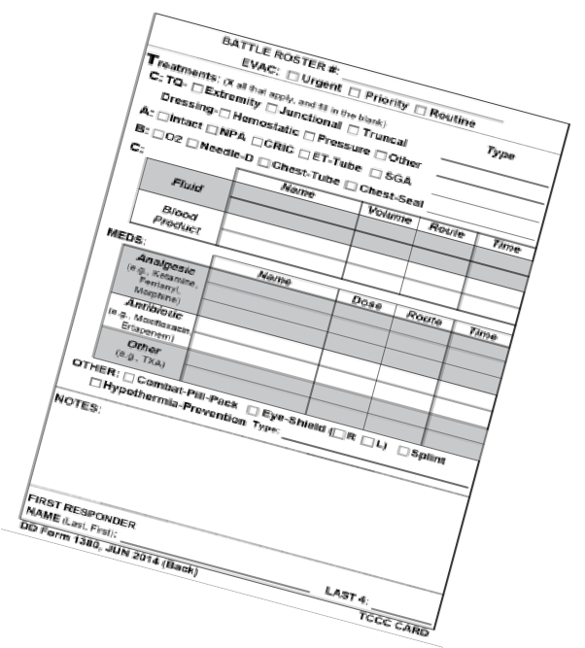
Module 5: Tactical Trauma Assessment
PREPARE FOR EVACUATION
PREP CASUALTY
PREP SITE AND EVAC SUPPORT
Prep evac equipment Prep litter
Pack casualty Secure loose items
(bandages, blankets, etc.)
Establish security
Instruct ambulatory casualties
Stage casualties
COMMUNICATE CASUALTY STATUS
Monitor the Casualty
Continue to REASSESS / REASSURE and monitor the casualty during evacuation preparation phase
Ensure Completion MIST Report
Complete DD Form 1380
M Mechanism of injury
I Injuries
Symptoms
Treatment
PREPARE EVAC REQUEST
Use MEDEVAC format
Notes:
Presenter
2023-11-22 10:58:34
--------------------------------------------
Preparing for evacuation involves several steps.
First, prepare the casualty to be evacuated (secure loose bandages, equipment, blankets, etc.) and place them on a litter appropriate for the type of evacuation.
Second, prepare the site by directing the supporting personnel to establish security and a casualty movement process (often with litter-bearer teams), and by staging the casualties in the correct priority for evacuation.
Finally, prepare the incoming evacuation assets by communicating with them about the casualty status using the MIST (Mechanism of injury, Injuries sustained, Symptoms, and Treatment) report, as well as identifying any anticipated requirements during the evacuation.

Slide 22
TACTICAL TRAUMA ASSESSMENT
Module 5: Tactical Trauma Assessment
INSTRUCTOR-LED Demonstration (Trainer-led demonstration and/or student-led review of the TTA sequence/key steps)
Notes:
Presenter
2023-11-22 10:58:34
--------------------------------------------
In the skills station, we will practice identifying the basic sequence of a tactical trauma assessment without focusing on interventions that will be covered in later modules. By the end of the course, you should be prepared to perform a TTA to include all necessary interventions.
At the skill station, the trainer(s) can lead another tactical trauma assessment done in “real-time” to refresh the students’ memory of the steps and/or they can have the students methodically go through the basic steps of a TTA without focusing on interventions, but on the sequence of activities they will need to follow. Based on what we’ve talked about in this module and this TTA example, do you have any comments or questions?

Slide 23
SKILL STATION
Module 5: Tactical Trauma Assessment
TACTICAL TRAUMA ASSESSMENT
Notes:
Presenter
2023-11-22 10:58:35
--------------------------------------------
In the skills station, we will practice identifying the basic sequence of a tactical trauma assessment without focusing on interventions that will be covered in later modules. By the end of the course, you should be prepared to perform a TTA to include all necessary interventions.
At the skill station, the trainer(s) can lead another tactical trauma assessment done in “real-time” to refresh the students’ memory of the steps and/or they can have the students methodically go through the basic steps of a TTA without focusing on interventions, but on the sequence of activities they will need to follow. Based on what we’ve talked about in this module and this TTA example, do you have any comments or questions?

Slide 24
SUMMARY
Module 5: Tactical Trauma Assessment
Knowledge Topics
Define Tactical Trauma Assessment
Determine common causes of and techniques to assess altered mental status
Disarm and remove communication equipment when mental status is altered
Communicate with the casualty throughout the TTA
Consider body substance isolation
Skills and Abilities
Perform TTA following the MARCH PAWS sequence
Notes:
Presenter
2023-11-22 10:58:35
--------------------------------------------
The Tactical Trauma Assessment is the process of assessing injuries, prioritizing treatments, and coordinating the care of a combat casualty.
Understanding common causes of and techniques to assess altered mental status is an important concept, especially since casualties whose mental status is altered must be disarmed and have their communication equipment removed. Communicating with the casualty throughout the TTA is important to reassure them and maximize their response to any treatments rendered and provide valuable insights into the casualty’s status over the course of their treatment. When feasible, maintain body substance isolation.
The Tactical Trauma Assessment should follow the MARCH PAWS sequence to ensure a standardized approach that has been shown to yield the best outcomes for combat casualties. Time permitting, a more detailed physical exam can be performed before preparing the casualty for evacuation to the next level of medical care.

Slide 25

CHECK ON LEARNING
Module 5: Tactical Trauma Assessment
During which phase of care is most of the Tactical Trauma Assessment performed?
What mnemonic is used to prioritize care during the Tactical Trauma Assessment?
Why is it important to assess the casualty’s mental status?
What is the importance of performing a blood sweep?
Notes:
Presenter
2023-11-22 10:58:35
--------------------------------------------
Ask questions of the learners, referring to key concepts from the module. Now for a check on learning.
In which phase of care is most of the Tactical Trauma Assessment performed? Tactical Field Care
What mnemonic is used to prioritize care in the Tactical Trauma Assessment? MARCH PAWS
Why is it important to assess the casualty’s mental status?
They may need to be disarmed and to have communications equipment removed. Following their mental status throughout the assessment may help responders identify changes in clinical status, leading to early casualty reassessment.
What is the importance of performing a blood sweep?
A blood sweep is a rapid visual and palpable head-to-toe check of the front and back of the casualty to check and treat for any unrecognized life-threatening bleeding.

Slide 26




Module 5: Tactical Trauma Assessment
ANY QUESTIONS?

Slide 27
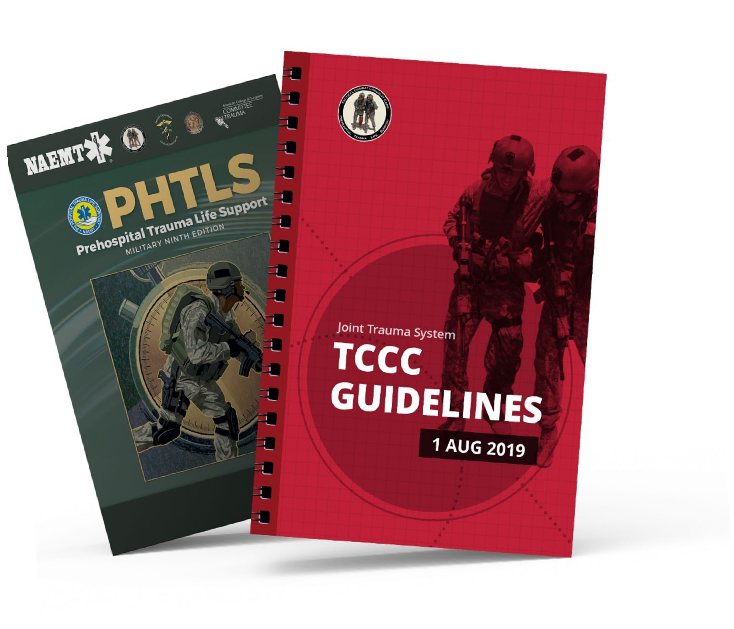

REFERENCES
Module 5: Tactical Trauma Assessment
TCCC: Guidelines
by JTS/CoTCCC
These guidelines, updated regularly, are the result of decisions made by CoTCCC in exploring evidence-based research on best practices.
PHTLS: Military Edition
by NAEMT
Prehospital Trauma Life Support (PHTLS), Military Edition, teaches and reinforces the principles of rapidly assessing a trauma patient using an orderly approach.

